Slide 1
ITMD 536 Software Testing & Maintenance
Chapter 6 Tool Support for Testing

Slide 2
Objectives
What is a tool?
What is the use of a tool?
Who needs tools?
What are the benefit of using tools?
What is use of tools in technology?
What tools are used in testing?
What are the risks of using test tools?
How do you introduce a test tool?

Slide 3
Tool Support for Testing
A tool is any physical item that can be used to achieve a goal, especially if the item is not consumed in the process.
Different tools are: "instrument", "utensil", "machine", "device," or "apparatus". The set of tools needed to achieve a goal is "equipment". The knowledge of constructing, obtaining and using tools is technology.

Slide 4
6.1 Types of Test Tool
Types of test tools used in software testing are:
Test execution tools,
Performance testing tools,
Static analysis tools,
Test management tools,
Capture/playback tools,

Slide 5
6.1 Types of Test Tool
Configuration management tools,
Coverage tools,
Debugging tools,
Dynamic analysis tools,
Incident management tools,
Load testing tools,
Modelling tools,

Slide 6
6.1 Types of Test Tool
Monitoring tools,
Probe effect,
Requirement management tools,
Review tools,
Security testing tools,
Security tools,
Static code analysis,

Slide 7
6.1 Types of Test Tool
Static code analyzer,
Stress testing tools,
Test comparator,
Test comparison,
Test data preparation tools,
Test design tools,
Test framework,

Slide 8
6.1 Types of Test Tool
Unit test framework tools and
Volume testing tools.

Slide 9
6.1.1 Understanding the Meaning and Purpose of Tool Support for Testing
Tools are used directly in testing.
Tools helps manage testing process.
Tools can monitor file activity for an application.
Tools can be spreadsheets to manage test assets or progress document automated or manual tests.

Slide 10
6.1.1 Understanding the Meaning and Purpose of Tool Support for Testing
Test Execution Tools (include via so-called test frameworks)
Test Framework: It has three distinct meanings:
1. Reusable and extensible testing libraries that can be used to build testing tools (which are also called test harness);

Slide 11
6.1.1 Understanding the Meaning and Purpose of Tool Support for Testing
2. A type of design of test automation (e.g., data-driven and, keyword-driven); and,
3. An overall process of execution of testing. In the Foundation syllabus, and in this book, especially in this chapter, we use the term test frameworks in its first two meanings.

Slide 12
6.1.2 Test Tool Classification
Tools are grouped by the testing activities to support management activities, tools to support static testing etc.
There are certain things that computers can do much faster than humans such as add up 20 three-digit numbers quickly?

Slide 13
6.1.2 Test Tool Classification
A tool that measures some aspect of software may have unexpected side-effects on that software.
For example, a tool that measures timings for non-functional (performance) testing needs to interact very closely with that software in order to measure it.

Slide 14
6.1.2 Test Tool Classification
A performance tool will set a start time will set a start time and a stop time for a given transaction in order to measure the response time, for example.
But the act of taking that measurement, i.e. storing the time at those two points, could actually make the whole transaction take slightly longer than it would do if the tool wasn’t measuring the response time.

Slide 15
6.1.2 Test Tool Classification
Probe Effect: The effect on the component or system by the measurement instrument when the component or system is being measured, e.g. by a performance testing tool or monitor. For example performance may be slightly worse when performance testing tools are being used.

Slide 16
6.1.3 Tool Support for Management of Testing and Tests
Test Management Tool: A tool that provides support to the test management and control part of a test process.
It often has several capabilities, such as testware management, scheduling of tests, the logging of results, progress tracking, incident management and test reporting.

Slide 17
6.1.3 Tool Support for Management of Testing and Tests
Interfaces to other tools:
Test execution tools (test running tools);
Incident management tools;
Requirement management tools;
Configuration management tools;

Slide 18
6.1.3 Tool Support for Management of Testing and Tests
Requirement management tool: A tool that supports the recording of requirements, requirements attributes and annotation, and facilitates traceability through layers of requirements and requirement change management. (Rational&Jira)

Slide 19
6.1.3 Tool Support for Management of Testing and Tests
Some requirements management tools also provide facilities for static analysis such as consistency checking and violations to pre-defined requirements rules.
Storing, checking consistency, gaps, prioritizing, traceability, interfacing and coverage of requirements by set of tests.

Slide 20
6.1.3 Tool Support for Management of Testing and Tests
Incident management tool (defect management tool): A tool that facilitates the recording and status tracking of incidents. They often have workflow-oriented facilities to track and control the allocation, correction and re-testing of incidents and provide reporting facilities.(Remedy,Jira,Redmine&Bugzilla

Slide 21
6.1.3 Tool Support for Management of Testing and Tests
Storing incidents severity,
Storing attachments,
Prioritizing incidents,
Assigning actions to people,
Status,
Reporting statics/metrics

Slide 22
6.1.3 Tool Support for Management of Testing and Tests
Configuration management tool: A tool that provides support for the identification and control of configuration items, their status over changes and versions, and the release of baselines consisting of configuration items.(CMDB, Clear Case…)

Slide 23
6.1.3 Tool Support for Management of Testing and Tests
Storing information about versions and builds of the software, testware
Traceability between software and testware versions and variants,
Track which version belongs to which configuration (operating systems, libraries and browsers)

Slide 24
6.1.3 Tool Support for Management of Testing and Tests
Build and release management,
Baseline (e.g. all the configuration items that make up a specific release);
Access control (checking in and out).

Slide 25
6.1.4 Tool Support for Static Testing
Static Testing: Testing of a component or system at specification or implementation level without execution of that software, e.g. reviews or static analysis.

Slide 26
6.1.4 Tool Support for Static Testing
Review Tool: A tool that provides support to the review process, Typical features include review planning and tracking support, communication support, collaborative reviews and a repository for collecting and reporting of metrics.

Slide 27
6.1.4 Tool Support for Static Testing
A common reference for the review process or processes;
Storing and sorting review comments;
Keeping track of comments;
Providing traceability;
Repository for rules, procedures & checklists, entry and exit criteria;
Monitoring the reviews & collecting metrics

Slide 28
6.1.4 Tool Support for Static Testing
Static Analysis Tool (static analyzer): A tool that carries out static analysis.
Static analysis tools are normally used by developers as part of the development and component testing process.

Slide 29
6.1.4 Tool Support for Static Testing
Static Code Analyzer: A tool that carries out static code analysis. The tool checks source code, for certain properties such as conformance to coding standards, quality metrics or data flow anomalies.
Static Code Analysis: Analysis of source code carried out without execution of that software.

Slide 30
6.1.4 Tool Support for Static Testing
Calculate metrics such as cyclomatic complexity or nesting levels;
Enforce coding standards,
Analyze structures and dependencies;
Aid in code understanding
Identify anomalies or defects in the code.

Slide 31
6.1.4 Tool Support for Static Testing
Modeling Tools (D): A tool that supports the creation, amendment and verification of models of the software or system.
This tool helps to validate models of the system or software.
Checks the consistency

Slide 32
6.1.4 Tool Support for Static Testing
Identifies inconsistencies and defects within the model;
Helps to identify and prioritize areas of the model for testing;
Predicting system response and behavior under various situations, such as load;
Identify test conditions using modeling language such as UML.

Slide 33
6.1.5 Tool Support for Test Specification
Test design tool: A tool that supports the test design activity by generating test inputs from a specification that may be held in a CASE tool repository, e.g. requirements managements tool, from specified test conditions held in the tool itself, or from code.

Slide 34
6.1.5 Tool Support for Test Specification
Generating test input values from:
Requirements;
Design models (state, data or object);
Code;
Graphical user interfaces;
Test conditions;
Generating expected results

Slide 35
6.1.5 Tool Support for Test Specification
Test Data Preparation Tool: A type of test tool that enables data to be selected from existing databases or created, generated, manipulated and edited for use in testing.
Enables data to be selected from and existing database or created, generated, manipulated and edited for use in tests.

Slide 36
6.1.5 Tool Support for Test Specification
Extract selected data records from files of database;
‘Message’ data records to make them anonymous (data protection);
Enable records to be stored or arranged in different order;
Generate new records;
Construct a large number of similar records from a template

Slide 37
6.1.6 Tool Support for Test Execution and Logging
Test Execution Tool: A type of test tool that is able to execute other software using an automate test script, e.g. capture/playback.

Slide 38
6.1.6 Tool Support for Test Execution and Logging
Capture/Playback Tool: A type of test execution tool where inputs are recorded during manual testing in order to generated automated test scripts that can be executed later (i.e. replayed). These tools are often used to support automated regression testing.

Slide 39
6.1.6 Tool Support for Test Execution and Logging
Test execution tools use a scripting language to drive the tool.
It is difficult to maintain the capture script because:
It is closely tied to the flow and interface presented by the GUI.

Slide 40
6.1.6 Tool Support for Test Execution and Logging
It may rely on the circumstances, state and context of the system at the time the script was recorded.
The test input information is ‘hard-coded’, i.e. it is embedded in the individual script for each test.

Slide 41
6.1.6 Tool Support for Test Execution and Logging
Capturing (recording) test inputs while inputs tests are executed manually;
Storing and expected result in the form of a screen or object to compare to, the next time the test is run;
Executing tests from stored scripts and optionally data files accessed by the script

Slide 42
6.1.6 Tool Support for Test Execution and Logging
Dynamic comparison (while the test is running) of screens, elements, links controls, objects and values;
Ability to initiate post-execution comparison;
Logging results (pass/fail)
Masking of filtering

Slide 43
6.1.6 Tool Support for Test Execution and Logging
Measuring timings for tests;
Synchronizing inputs with the application under test, e.g. wait until the application is ready to accept the next input, or insert a fixed delay to represent human interaction speed;
Sending summary results to a test management tool.

Slide 44
6.1.6 Tool Support for Test Execution and Logging
Test harness/unit test framework tools (D):
A test harness provides stubs and drivers, which are small programs that interact with the software under test.

Slide 45
6.1.6 Tool Support for Test Execution and Logging
Unit test framework tool: A tool that provides an environment for unit or component testing in which a component can be tested in isolation or with suitable stubs and divers. It also provides other support for the developer, such as debugging capabilities.

Slide 46
6.1.6 Tool Support for Test Execution and Logging
Supplying inputs to the software being tested;
Receiving outputs generated by the software being tested;
Executing a set of tests within the framework or using the test harness;
Recording the pass/fail

Slide 47
6.1.6 Tool Support for Test Execution and Logging
Storing tests
Support for debugging
Coverage measurement at code level

Slide 48
6.1.6 Tool Support for Test Execution and Logging
Test comparators: A test tool to perform automated test comparison of actual results with expected results.
A test comparator helps automated aspects of that comparison. (stand-alone tool)

Slide 49
6.1.6 Tool Support for Test Execution and Logging
Test comparison: The process of identifying differences between the actual results produced by the component or system under test and the expected results for a test. Test comparison can be performed during test execution (dynamic comparison) or after test execution. (batch run)

Slide 50
6.1.6 Tool Support for Test Execution and Logging
Dynamic comparison of transient events that occur during test execution;
Post-execution comparison of stored data, e.g. in files or databases;
Masking or filtering of subsets of actual and expected results.

Slide 51
6.1.6 Tool Support for Test Execution and Logging
Coverage measurement tools (D):
A tool that provides objective measures of what structural elements, e.g. statements, branches have been exercised by a test suite.
A coverage tool first identifies the elements or coverage items that can be counted.

Slide 52
6.1.6 Tool Support for Test Execution and Logging
Identifying coverage items
Calculating the percentage of coverage items that were exercised by a suite of tests;
Reporting coverage items that have not been exercised as yet;

Slide 53
6.1.6 Tool Support for Test Execution and Logging
Identifying test inputs to exercise as yet uncovered items ( test design tool functionality);
Generating stubs and drivers (if part of a unit test framework)
The coverage tools only measure the coverage of the items that they can identify.

Slide 54
6.1.6 Tool Support for Test Execution and Logging
Security testing tool: A tool that provides support for testing security characteristics and vulnerabilities.
Security: Attributes of software products that bear on its ability to prevent unauthorized access, whether accidental or deliberate, to programs and data.

Slide 55
6.1.6 Tool Support for Test Execution and Logging
Security tool: A tool that supports operational security.
Security testing tool can be used to test security by trying to break into a system, whether or not its protected by a security tool.
Identifying viruses;

Slide 56
6.1.6 Tool Support for Test Execution and Logging
Detecting intrusions such as denial of service attacks;
Simulating various types of external attacks;
Probing for open ports to other externally visible points of attack;

Slide 57
6.1.6 Tool Support for Test Execution and Logging
Identifying weaknesses in password files and passwords;
Security checks during operation, e.g. for checking integrity of files, and intrusion detection, e.g. checking results of test attacks.

Slide 58
6.1.7 Tool support for performance and monitoring
Dynamic analysis tool: A tool that provides run-time information on the state of the software code. These tools are most commonly used to identify unassigned pointers, check, pointer arithmetic and to monitor the allocation, use and del-allocation of memory and to flag memory leaks.

Slide 59
6.1.7 Tool support for performance and monitoring
Detecting memory leaks;
Identifying pointer arithmetic errors such as null pointers;
Identifying time dependencies.
It helps find dead links.

Slide 60
6.1.7 Tool support for performance and monitoring
Performance-testing, load-testing and stress-testing tools: A tool to support performance testing that usually has two main facilities load generation and test transaction measurement. Load generation can simulate either multiple users or high volumes of input data.

Slide 61
6.1.7 Tool support for performance and monitoring
During execution, response time measurements are taken from selected transactions and these are logged. Performance testing tools normally provide reports based on test logs and graphs of load against response times.

Slide 62
6.1.7 Tool support for performance and monitoring
A ‘load’ test checks that the system can cope with its expected number of transactions.
Volume testing: Testing where the system is subjected to large volumes of data.
A volume test checks the large volume of data.

Slide 63
6.1.7 Tool support for performance and monitoring
Stress testing tool: A tool that supports stress testing.
A stress test is one that goes beyond the normal expected usage of the system with respect to load or volume.

Slide 64
6.1.7 Tool support for performance and monitoring
Generating a load on the system to be tested;
Measuring the timing of specific transactions as the load on the system varies;
Measuring average response times;
Producing graphs or charts of response time.

Slide 65
6.1.7 Tool support for performance and monitoring
Monitoring tools: A software tool or hardware device that runs concurrently with the component or system under test and supervises, records and/or analyzes the behavior of the component or system.

Slide 66
6.1.7 Tool support for performance and monitoring
Monitoring tools are used to continuously keep track of the status of the system in use, in order to have the earliest warning of problems and to improve services. Monitoring tools for servers, networks, databases, security, performance, website and internet usage, and applications.

Slide 67
6.1.7 Tool support for performance and monitoring
Identifying problems and sending and alert message to the administrator;
Logging real-time and historical information;
Finding optimal settings;

Slide 68
6.1.7 Tool support for performance and monitoring
Monitoring the number of users on a network;
Monitoring network traffic (either in real time or covering a given length of time of operations with the analysis performed afterwards).

Slide 69
6.1.8 Tool support for specific application areas (K1)
Web-based performance-testing tools, as well as performance- testing tools for back-office systems.
Dynamic analysis tools that focus on security issues, as well as dynamic analysis tools for embedded systems.
Commercial tool sets may be bundled for web-based or embedded systems.

Slide 70
6.1.9 Tool support using other tools
Testing tools used by the testers are SQL to set up and query databases containing test data. Tools used by the developers when debugging, to help localize defects and check their fixes are also testing tools. Developers use debugging tools when identifying and fixing defects.

Slide 71
6.1.9 Tool support using other tools
Debugging tool: A tool used by programmers to reproduce failures, investigate the state of programs and find the corresponding defect. Debugging enable programmers to execute programmers to execute programs step by step, to halt a program at any program statement and to set and examine program variables.

Slide 72
6.1.10 Tool support for specific testing needs
Tools should be used for data quality assessment, including reviewing and verifying data conversion and migration rules.

Slide 73
6.1.10 Tool support for specific testing needs
Tools can help ensure that the processed data is correct, and complete, and that it complies to pre-defined, context-specification standards, even when the volume of data is large. You can also use tools for usability testing.

Slide 74
6.2 Effective use of Tools: Potential Benefits and Risks
The reason for acquiring tools to support testing is to gain benefits, by using a software program to do certain tasks that are better done by a computer than by a person.

Slide 75
6.2.1 Potential benefits of using tools
Benefits include:
Reduction of repetitive work;
Greater consistency and repeatability;
Objective assessment;
Ease of access to information about tests or testing.

Slide 76
6.2.2 Risks of using tools
Risks include:
Unrealistic expectations for the tool;
Underestimating the time, cost and effort needed to achieve significant and continuing benefits from the tool;
Understanding the effort required to maintain the test assets generated by the tool;

Slide 77
6.2.2 Risks of using tools
Over-reliance on the tool, including relying on tools for test design or test execution where manual testing would work better.
Failing to use proper configuration management and version control facilities for the test assets created for and by the tool;

Slide 78
6.2.2 Risks of using tools
Failing to consider and mange issues related to relationships and interoperability between critical tools, such as requirements management tools, version control tools, incident management tools, defect tracking tools and tools from multiple vendors;

Slide 79
6.2.2 Risks of using tools
Possibility of the tool vendor going out of business, retiring the tool, or selling the tool to a different vendor, or in the open-source world, the possibility of orphanage of the tool or suspension of the project by the open-source community;

Slide 80
6.2.2 Risks of using tools
Poor or completely non-existent vendor response, whether for support, upgrades, or defect fixes;
Various uncertainties and unforeseen problems, such as the inability to support a new platform.
The skill needed to create good tests;
The skill needed to use the tools well, depending on the type of tool.

Slide 81
6.2.3 Special considerations for types of tools
Test execution tools: The test execution tool must have some way of knowing what to do – this is the script for the tool. The script becomes a program, written in a programming language.

Slide 82
6.2.3 Special considerations for types of tools
The scripting language may be specific to a particular tool, or it may be a more general language.
Scripting language: A programming language in which executable test scripts are written, used by a test execution tool (e.g. a capture/playback tool).

Slide 83
6.2.3 Special considerations for types of tools
Five levels of scripting by (Fewster and Graham):
Linear scripts (created manually or captured by recording a manual test);
Structured scripts (using selection and iteration programming structures);

Slide 84
6.2.3 Special considerations for types of tools
Shared scripts (where scripts can be called by other scripts so can be re-used – shared scripts also require a formal script library under configuration management);
Data-driven scripts (where test data is in a file or spreadsheet to be read by a control script);

Slide 85
6.2.3 Special considerations for types of tools
Keyword-driven scripts (where all of the information about the test is stored in a file or spreadsheet, with a single control scripts that implements the tests described in the file using shared and keyword scripts).

Slide 86
6.2.3 Special considerations for types of tools
The script doesn’t know what the expected result is until you program it in – it only stores inputs that have been recorded, not test case.
A small change to the software may invalidate dozens or hundreds of scripts.

Slide 87
6.2.3 Special considerations for types of tools
The recorded script can only cope with exactly the same conditions as when it was recorded. Unexpected events (e.g. a file that already exists) will not be interpreted correctly by the tool.

Slide 88
6.2.3 Special considerations for types of tools
Data driven scripts allow the data, i.e. the test inputs and expected outcomes to be stored separately from the script.

Slide 89
6.2.3 Special considerations for types of tools
Data-Driven: A scripting technique that stores test input and expected results in a table or spreadsheet, so that a single control script can execute all of the tests in the table. Data driven testing is often used to support the application of test execution tools such as capture/playback tools.

Slide 90
6.2.3 Special considerations for types of tools
Performance testing tool: A tool to support performance testing that usually has two main facilities: load generation and test transaction measurement. Load generation can simulate either multiple users or high volumes of input data.

Slide 91
6.2.3 Special considerations for types of tools
During execution, response time these are logged. Performance testing tools normally provide reports based on test logs and graphs of lead against response times.

Slide 92
6.2.3 Special considerations for types of tools
When using a performance testing tool we are looking at the transaction throughput, the degree of accuracy of a given computation, the computer resources being used for a given level of transactions, the time taken for certain transactions or the number of users that can use the system at once.

Slide 93
6.2.3 Special considerations for types of tools
The design of the load to be generated by the tool (e.g. random input or according to user profiles);
Timing aspects (e.g. inserting delays to make simulated user input more realistic);

Slide 94
6.2.3 Special considerations for types of tools
The length of the test and what to do if a test stops prematurely;
Narrowing down the location of a bottleneck;
Exactly what aspects to measure (e.g. user interaction level or server level);
How to present the information gathered.

Slide 95
6.2.3 Special considerations for types of tools
Static Analysis Tool: A tool that carries out static analysis.
Developers use this tool to identify potential problems in code before the code is executed and they can also help to check the code is written to coding standards.

Slide 96
6.2.3 Special considerations for types of tools
Static analysis tools can generate a large number of messages, for example by finding the same thing every few lines.

Slide 97
6.2.3 Special considerations for types of tools
Test management tool: A tool that provides support to the test management and control part of a test process. It often has several capabilities, such as testware management, scheduling of tests, the logging of results, progress tracking incident management and test reporting.

Slide 98
6.2.3 Special considerations for types of tools
It is important to have a defined test process before test management tools are introduced.
It is important to have a defined test process before test management tools are introduced.
If it’s working well manually it will work with test management tool.

Slide 99
6.3 Introducing a Tool into an Organization
6.3.1 Main Principles: Assessment of the organization’s maturity (e.g. readiness for change);
Identification of the areas within the organization where tool support will help to improve testing processes;
Evaluation of tools against clear requirements and objective criteria.

Slide 100
6.3.1 Main Principles
Proof-of-concept to see whether the product works as desired and meets the requirements and objectives defined for it;
Evaluation of the vendor (training, support and other commercial aspects) or open-source network of support;

Slide 101
6.3.1 Main Principles
Identifying and planning internal implementation (including training, coaching and mentoring for those new to the use of the tool);
Estimation of the return on investment (cost-benefit ratio) based on a concrete and realistic business case.

Slide 102
6.3.2 Pilot Project
One of the ways to do a proof-of-concept is to have a pilot project as the first thing done with a new tool.
This will use the tool in earnest but on a small scale, with sufficient time to explore different ways of using the tool.

Slide 103
6.3.2 Pilot Project
Objectives for this new tool are:
To learn more about the tool (more detail, more depth);
To see how the tool would fit with existing processes or documentation, how those would need to change to work well with the tool and how to use the tool to streamline existing processes;

Slide 104
6.3.2 Pilot Project
To decide on standard ways of using the tool that will work for all potential users (e.g. naming conventions, creation of libraries, defining modularity, where different elements will be stored, & maintained);
To evaluate the pilot project against its objectives.

Slide 105
6.3.3 Success Factors
Success is not guaranteed or automatic when implementing a testing tool, but many organization have succeeded.
Incremental roll-out (after the pilot);
Adapting and improving processes, testware and tool artefacts to get the best fit and balance between them and the use of the tool;

Slide 106
6.3.3 Success Factors
Providing adequate support, training, coaching and mentoring of new users;
Defining and communicating guidelines for the use of the tool, based on what was learned in the pilot;
Implementing a continues improvement mechanizing as a tool use spreads through more of the organizations;

Slide 107
6.3.3 Success Factors
Monitoring the use of the tool and the benefits achieved and adapting the use of the tool to take account of what is learned;
Provide continuing support for anyone using test tools, such as the test team; for example, technical expertise is needed to help non-programmer testers who use keyword-driven test automation;

Slide 108
6.3.3 Success Factors
Continuous improvement of tool use should be based on information gathered from all teams who are using test tools.

Slide 109
List of Testing Tools
Selenium
Quick Test Professional (QTP)
HP WinRunner
Test Manager
Rational Tester
Load Runner
Rational Quality Manager

Slide 110
List of Defect Tracking Tools
Jira
Remedy
Bugzilla
SMT
Tracker
Redmine

Slide 111
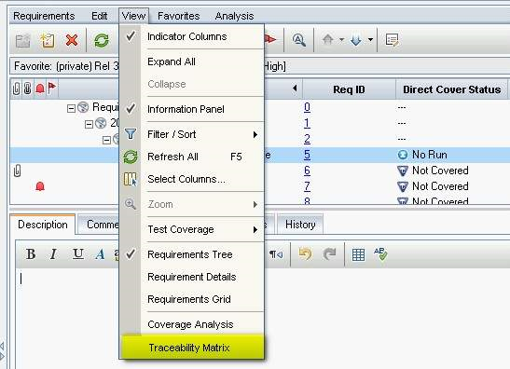

Slide 112
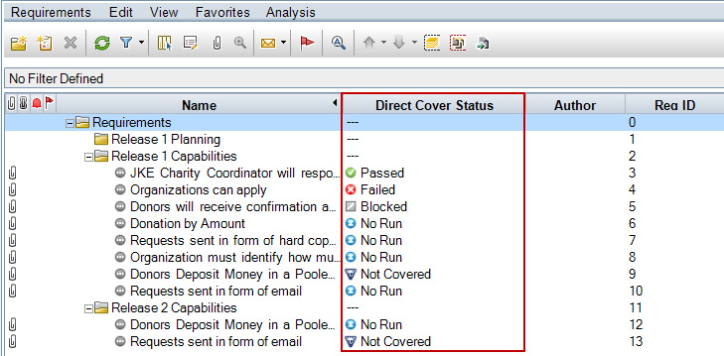

Slide 113
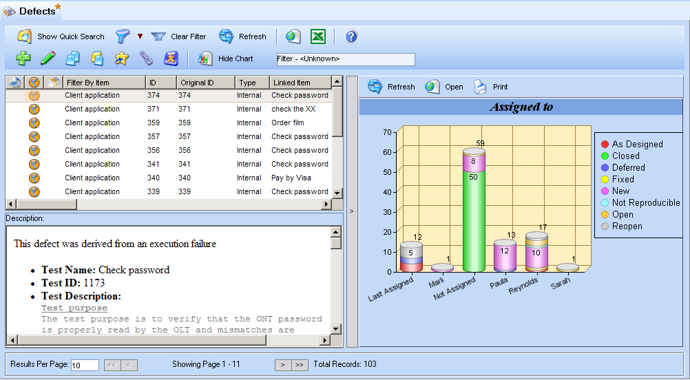

Slide 114
Sample Questions - 6
1. Which tools help to support static testing?
a. Static analysis tools, and test execution tools.
b. Review tools, static analysis tools, and coverage measurement tools.
c. Dynamic analysis tools, and modelling tools.
d. Review tools, static analysis tools, and modelling tools.

Slide 115
Sample Questions – 6
2. Which test activities are supported by test harness or unit test framework tools?
a. Test management and control.
b. Test specification and design.
c. Test execution and logging.
d. Performance and monitoring.

Slide 116
Sample Questions – 6
3. What are the potential benefits from using tools in general to support testing?
a. Greater quality of code, reduction in the number of testers needed, better objectives for testing.
b. Greater repeatability of tests, reduction in repetitive work, objective assessment.
c. Greater responsiveness of users, reduction of tests run, objectives not necessary.
d. Greater quality of code, reduction in paperwork, fewer objections to the tests.

Slide 117
Sample Questions - 6
4. What is a potential risk in using tools to support testing?
a. Unrealistic expectations, expecting the tool to do too much.
b. Insufficient reliance on the tool, i.e. still doing manual testing when a test execution tool has been purchased.
c. The tool may find defects that aren’t there.
d. The tool will repeat exactly the same thing it did the previous time.

Slide 118
Sample Questions – 6
5. Which of the following are advanced scripting techniques for test execution tools?
a. Data-driven and keyword-driven.
b. Data-driven and captured-driven.
c. Capture-driven and keyhole-driven.
d. Playback-driven and keyword-driven.

Slide 119
Sample Questions – 6
6. Which of the following would NOT be done as part of selecting a tool for an organization?
a. Assess organizational maturity, strengths, and weaknesses.
b. Roll out the tool to as many users as possible within the organization.
c. Evaluate the tool features against clear requirements and objective criteria.
d. Identify internal requirements for coaching and mentoring in the use of the tool.

Slide 120
Sample Questions – 6
7. Which of the following is a goal for a proof-of-concept or pilot phase for tool evaluation?
a. Decide which tool to acquire.
b. Decide on the main objectives and requirements for this type of tool.
c. Evaluate the tool vendor including training, support, and commercial aspects.
d. Decide on standard ways of using, managing, storing, and maintaining the tool and the test assets.

